Slide 1
OEM DeskPhone
Automation Framework
CLI-first + GUI Interactive Mode + Multi-DUT Runtime
统一管理 SIP / NOE、API / Physical Backend，以及 1–5 台 DUT 的测试执行
Case-driven
Configuration-driven
Single Core
Role-based Binding
面向 YY 与 Automation / QA 团队
Notes:
[Sources]
Internal background: <File>DeskPhone ALE-2&ALE-3 R510 Validation Delivery Note.docx</File> (reference_id 5020).
[/Sources]

Slide 2
01｜目标与设计原则
先统一测试语言，再隔离产品实现差异
Case-driven
Configuration-driven
CLI-first
Single Automation Core
Case Repository 描述可执行的测试能力；运行时从库中选择适用 Case。
Device Profile 与 Lab Config 定义本次测试对象、能力与可用资源。
CLI 是 Jenkins / CI 的正式入口；GUI 是可选 Interactive Mode。
GUI 与 CLI 共享 Test Plan、Parser、Binder、Executor 与 Evidence。
核心架构判断
Case 定义 WHAT；Config 定义 available capabilities；Resolver 决定由谁实现；Provider 定义 HOW；Executor 决定何时执行。
Notes:
[Sources]
Architecture recommendation developed from the confirmed design in this conversation.
Internal validation scope reference: <File>DeskPhone ALE-2&ALE-3 R510 Validation Delivery Note.docx</File> (reference_id 5020).
[/Sources]

Slide 3
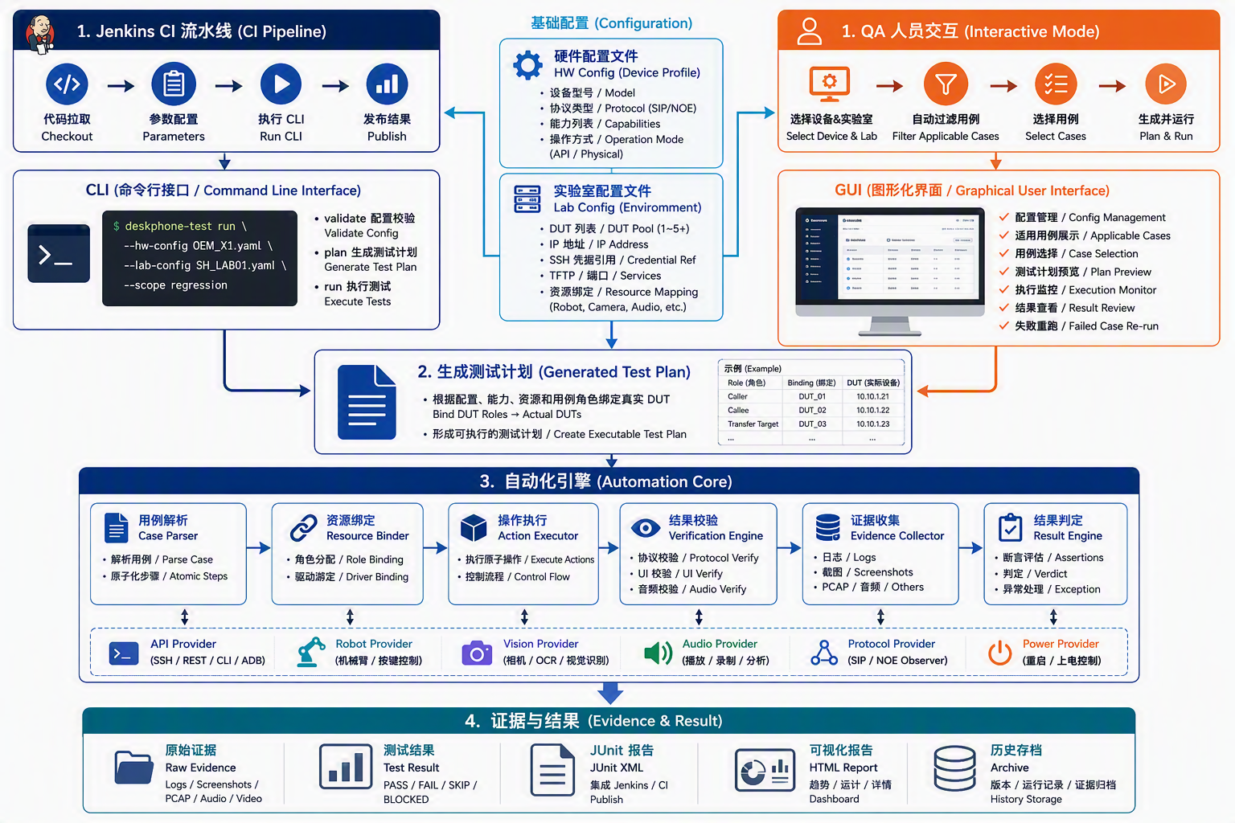
02｜High-level Architecture
Jenkins / CLI 与 QA / GUI 汇合到同一个 Test Plan 和 Automation Core
Notes:
[Sources]
Visual on this slide was generated with Microsoft Copilot.
Architecture content is based on the user-confirmed framework design.
[/Sources]

Slide 4
03｜Initialization：配置先定义运行上下文
Run 之前完成配置补充与校验，避免执行阶段再猜测环境
Device Profile / HW Config
Lab Config / Instance Config
Runtime Context
描述设备类型，而非设备实例
协议：SIP / NOE
Capabilities：Hold、Transfer、Conference…
Operation mode：API / Physical
支持的 Provider / key map
描述真实 DUT instances
IP / SSH port / Credential reference
TFTP / Network / Audio service
Robot / Camera / Power resource mapping
External platform context
合并静态能力与本次实验室实例
构建 DUT Pool
暴露 protocol / capabilities / backend
提供资源句柄，而非明文 secrets
供 Case Filter 与 Binder 使用
Sensitive credentials：Config 只保存 credential reference；真实 password / token / private key 在运行时由受控 Secret Provider 注入。
Notes:
[Sources]
Architecture recommendation developed from the confirmed design in this conversation.
[/Sources]

Slide 5
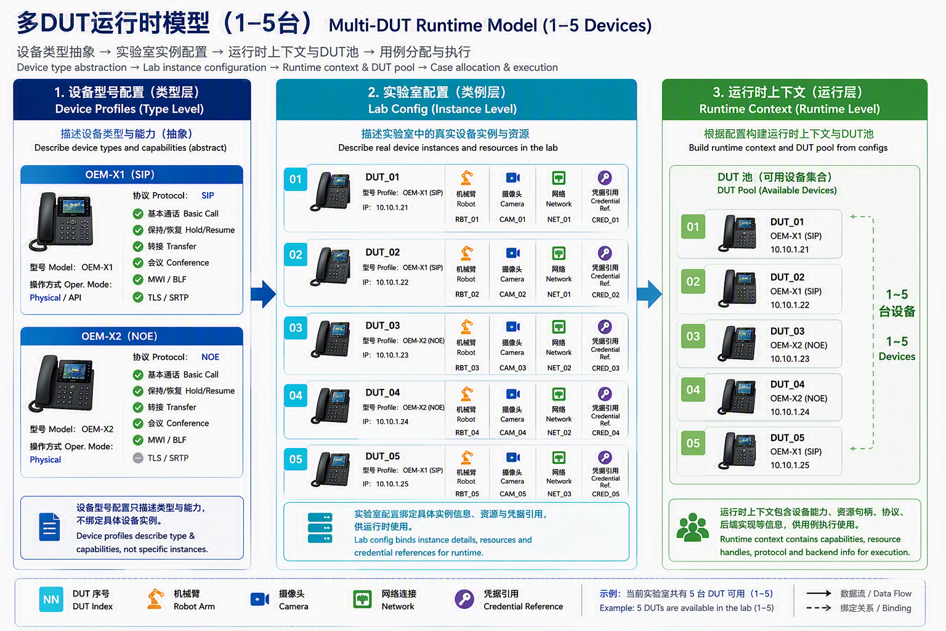
04｜Multi-DUT Runtime Model（1–5 台）
Device Profile 描述类型；Lab Config 描述实例；Runtime Context 构建 DUT Pool
Notes:
[Sources]
Visual on this slide was generated with Microsoft Copilot.
Multi-DUT model is an architecture recommendation based on the user-confirmed requirements.
[/Sources]

Slide 6
05｜Case Repository & Selection
完整 Case 库经过 Context 与资源条件过滤，生成 Applicable Case List
Common Cases
SIP Cases
NOE Cases
Case Metadata
Basic Call
Hold / Resume
Transfer / Conference
UI / Audio / Reboot
REGISTER / Authentication
SDP / TLS / SRTP
SIP timers / robustness
NOE initialization
NOE signaling
NOE recovery / security
Protocol / category
Required capabilities
Required DUT roles
Required resources
Runtime Context
Protocol + Capability
DUT Count + Roles
Physical Resources
Applicable Cases
状态必须区分：NOT_APPLICABLE（协议/能力不适用）｜BLOCKED_RESOURCE（DUT 或台架资源不足）｜CONFIG_ERROR｜READY
Notes:
[Sources]
Architecture recommendation developed from the confirmed design in this conversation.
[/Sources]

Slide 7
06｜Generated Test Plan：标准执行边界
把“准备什么”冻结为可审计、可复现、可由 CLI 或 GUI 执行的计划
Inputs
Generated Test Plan
Consumers
run_id: OEM_X1_R100_001
DUT Pool: dut_01 … dut_05
Environment: SH_LAB_01
Selected Cases: …
Role Bindings:
caller → dut_01
callee → dut_02
host → dut_01
participant_1 → dut_02
participant_2 → dut_03
Expected artifacts: JUnit / PCAP / Screen / Audio
• Device Profiles
• Lab Config / DUT Pool
• Selected scope
• Applicable Case List
• CLI / GUI parameters
CLI run
GUI preview / run
Automation Core
Jenkins artifact
Re-run failed cases
Notes:
[Sources]
Architecture recommendation developed from the confirmed design in this conversation.
[/Sources]

Slide 8
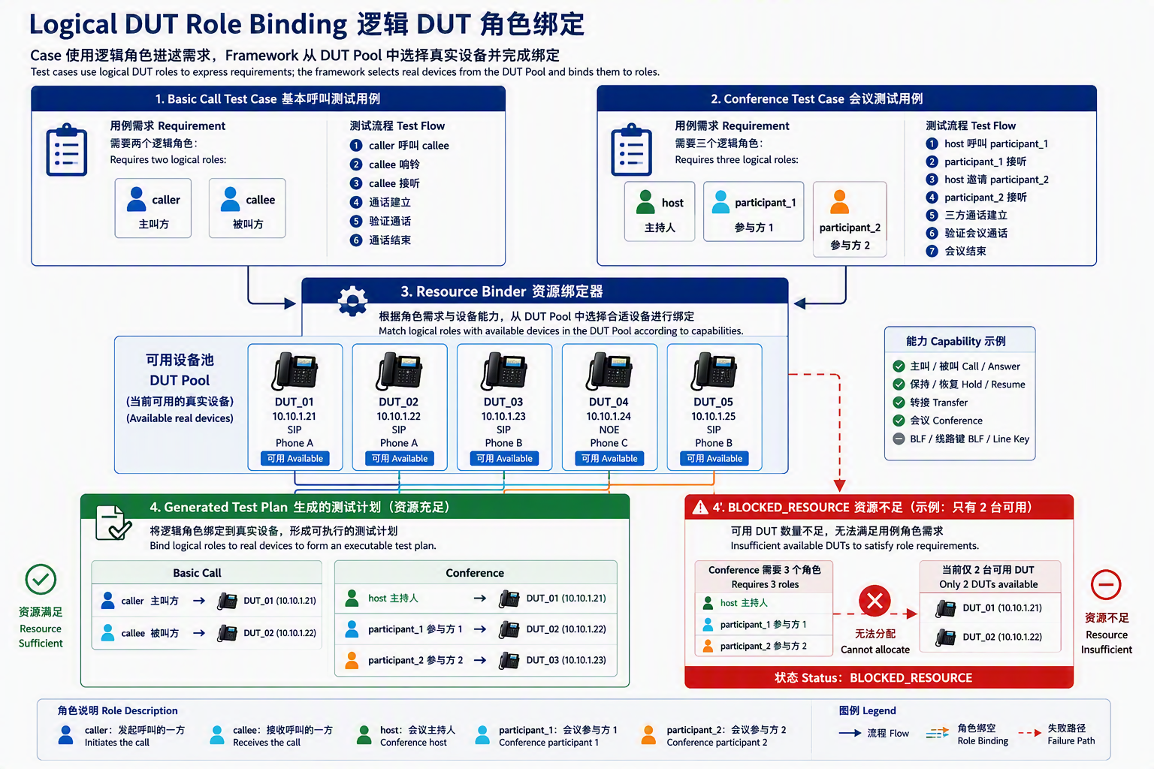
07｜Logical DUT Role Binding
Case 引用逻辑 Role；Resource Binder 在生成 Test Plan 时映射到真实 DUT
Notes:
[Sources]
Visual on this slide was generated with Microsoft Copilot.
Role-binding examples are architecture recommendations based on the user-confirmed requirements.
[/Sources]

Slide 9
08｜Unified Execution Flow
只有选中的 Case 才进入完整解析、角色绑定、Provider 绑定与执行
1
Load & Validate Config
6
Bind Action / Verify Providers
2
Build Runtime Context / DUT Pool
7
Pre-check & Reserve Resources
3
Discover & Filter Cases
8
Execute in Order
4
Generate Test Plan / Role Binding
9
Evidence → Verdict → Report
5
Full Parse → Atomic Steps
10
Cleanup & Release
Notes:
[Sources]
Architecture recommendation developed from the confirmed design in this conversation.
[/Sources]

Slide 10
09｜Automation Core Layered Architecture
Case 描述 WHAT；具体 OEM 差异留在 Resolver / Provider 层
Case Definition
业务意图与角色需求：caller / callee / host …
Case Parser / Compiler
把 selected case 转换为有序 Atomic Steps
Abstract Action / Verification
phone.hold / verify.call_on_hold；不包含 OEM 命令或坐标
Executor
控制顺序、timeout、retry policy、cleanup 与 step result
Resolver / Binder
DUT Role → DUT Instance；Action/Verify → Provider
Provider Implementation
SSH / REST / OEM CLI / Robot / Camera / Protocol / Audio
Evidence / Verdict
记录每步证据并生成 PASS / FAIL / BLOCKED / ERROR
Notes:
[Sources]
Architecture recommendation developed from the confirmed design in this conversation.
[/Sources]

Slide 11
10｜同一个 Hold Case，不同 OEM 实现
API / Physical 是 Implementation Strategy，不是不同的 Test Case
OEM A
Resolver / Provider 结果
COMMON_HOLD_001
phone.hold → SSH Provider
verify → API state
1. establish_call
2. phone.hold
3. verify.call_on_hold
4. phone.resume
5. verify.call_connected
Action Resolver
• 根据 DUT instance 与 backend 选择执行 Provider
Verify Resolver
• 根据可用 observer 选择 API / Camera / Protocol / Audio
Executor
• 只执行抽象 step，不包含 OEM-specific if/else
OEM B
phone.hold → REST Provider
verify → API + Protocol
OEM C
Case 不包含 SSH command、REST endpoint、Robot 坐标或 Camera 模型。
phone.hold → Robot Provider
verify → Camera + Protocol
Notes:
[Sources]
Architecture recommendation developed from the confirmed design in this conversation.
[/Sources]

Slide 12
11｜Responsibility Model
每一层只回答一个问题，避免 Case、Executor 与 OEM 实现相互污染
Config
我有什么设备、能力与资源？
Case
我要测试什么业务行为？
DUT Role
这个 Case 需要哪些逻辑设备角色？
Resource Binder
哪些真实 DUT 与台架资源承担这些角色？
Resolver
这个 Action / Verify 应交给哪个 Provider？
Provider
具体如何调用 SSH / REST / Robot / Camera？
Executor
什么时候执行、如何控制流程与异常？
Notes:
[Sources]
Architecture recommendation developed from the confirmed design in this conversation.
[/Sources]

Slide 13
12｜CLI-first & Jenkins Integration
Jenkins 负责 orchestration；测试逻辑只存在于 CLI / Automation Core
Jenkins Responsibilities
Framework Responsibilities
Trigger / schedule
Provide parameters
Reserve agent / workspace
Call CLI
Publish JUnit / artifacts
Archive Test Plan & evidence
$ deskphone-test validate …
$ deskphone-test plan …
$ deskphone-test run test-plan.yaml
$ deskphone-test rerun --failed …
Load & validate config
Build DUT Pool
Filter cases
Bind DUT roles/resources
Compile & execute
Collect evidence / verdict
CLI Primary Interface
新增 OEM / DUT 数量变化通常由 Profile、Lab Config、Provider 与 Case metadata 吸收；Jenkinsfile 不应包含 SIP/NOE 或 Robot/Camera 分支。
Notes:
[Sources]
Architecture recommendation developed from the confirmed design in this conversation.
[/Sources]

Slide 14
13｜GUI Interactive Mode
可选交互入口：快速选择 DUT、Applicable Cases 与 Test Plan；不包含执行逻辑
OEM DeskPhone Test Workspace
GUI 可以做
GUI 不应该做
DUT Pool: ☑ DUT_01 ☑ DUT_02 ☐ DUT_03
Lab: Shanghai-Lab-01
Scope: Smoke / Regression / Custom
Applicable Cases
☑ Common / Basic Call
☑ Common / Hold & Resume
☑ SIP / Registration
☐ NOE / Initialization Not Applicable
[Preview Test Plan] [Run]
Test Preparation
Applicable Case Selection
Test Plan Preview
Execution Monitor
Evidence Review
直接调用 Robot / Camera
直接执行 SSH / REST
自行解析 Case
复制一套 Executor
绕过 Test Plan
共享边界
GUI 与 CLI/Jenkins 使用同一个 Config Model、Applicable Case List、Generated Test Plan、Automation Core 和 Result Model。
Notes:
[Sources]
Architecture recommendation developed from the confirmed design in this conversation.
[/Sources]

Slide 15
14｜Delivery Roadmap & PoC Gates
先证明核心数据链与绑定模型，再扩展 CI 与交互体验
P0-A
P0-B
P0-C
P1
P2
Core Model
Execution Core
CLI
Jenkins
GUI
Schema / Config
Runtime Context / DUT Pool
Case metadata / Test Plan
Parser / Atomic Steps
Role & Provider Binding
Executor / Evidence
validate / list / plan / run
Structured exit codes
JUnit / artifacts
Parameterized pipeline
Resource reservation
Publish / archive
Interactive preparation
Case selection / monitor
Evidence & failed rerun
关键 PoC：① 1–5 DUT Pool 构建 ② Role→DUT Binding ③ 同一 Case 绑定 API / Physical Provider ④ BLOCKED_RESOURCE 识别 ⑤ Jenkins 发布结果
Notes:
[Sources]
Architecture recommendation developed from the confirmed design in this conversation.
[/Sources]

Slide 16
15｜Recommendation & Decisions Needed
建议采用该架构，并先锁定 5 个关键设计决策
CLI-first + Optional GUI
两个入口，共享同一 Test Plan 与 Automation Core
1
Two-stage Case Handling
metadata 用于选择；selected cases 才完整解析与编译
2
Multi-DUT Role Model
Case 引用逻辑 DUT Role，不引用具体 DUT instance
3
Resolver / Provider Separation
Case 定义 WHAT；Provider 定义 OEM-specific HOW
4
External Platform Boundary
OXE / OXO / Rainbow Hub 作为预配置 Test Context，不假设可控
5
预期扩展方式：新增 OEM 产品时优先增加 Device Profile、Lab instance mapping 与 Provider；避免复制完整 Test Suite。
Notes:
[Sources]
Architecture recommendation developed from the confirmed design in this conversation.
Internal validation scope reference: <File>DeskPhone ALE-2&ALE-3 R510 Validation Delivery Note.docx</File> (reference_id 5020).
[/Sources]

